Slide 1
Advanced Scaling with Python Using MPI
William Scullin
Assistant Computational Scientist Leadership Computing Facility Argonne National Laboratory

Slide 2
Why MPI?
It is the HPC paradigm for inter-process communications
Supported by every HPC center and vendor on the planet
APIs are stable, standardized, and portable across platforms and languages
We’ll still be using it in 10 years…
It makes full use of HPC interconnects and hardware
Abstracts aspects of the network that may be very system specific
Dask, Spark, Hadoop, and Protocol Buffers use sockets or files!
Vendors generally optimize MPI for their hardware and software
Well-supported tools for development – even for Python
Debuggers now handle mixed language applications
Profilers are treating Python as a first-class citizen
Many parallel solver packages have well-developed Python interfaces

Slide 3
Why not MPI?
Generally unsupported outside HPC contexts
Packages provided with a distribution may be highly un-tuned
Commercial cloud services generally don’t have fast interconnects
Mixing programming paradigms can be messy
MPI applications are generally synchronous – you only compute as fast as the slowest process
Generally projects use MPI+X where X is node-local
Mixing threading paradigms is generally a recipe for disaster
There can be a steep learning curve
Simple to learn, but difficult to master
APIs aren’t generally taught in CS programs
Best tools for debugging and profiling are generally commercial
Performance gains aren’t automatic

Slide 4
Where does MPI fit in?
Share of execution time

Slide 5
Python and MPI
Python was originally developed as a system scripting language for the Amoeba distributed operating system
Folks have been writing Python MPI bindings since at least 1996
David Beazley may have started this…
Other contenders: Pypar (Ole Nielsen), pyMPI (Patrick Miller, et al), Pydusa ( Timothy H. Kaiser), and Boost MPI Python (Andreas Klöckner and Doug Gregor)
The community has mostly settled on mpi4py by Lisandro Dalcin
You can mix bindings, libraries, and languages – just watch the MPI you link and your data types
Argonne has required vendor support as part of machine acquisitions since at least 2003.
Python 3 is the future – and the future is here
All major libraries now work under Python 3.5
Python 3’s loader and internals are more I/O intensive which presents challenges for scaling

Slide 6
Parallelism and Python: A Word on the GIL
To keep memory coherent, Python only allows a single thread to run in the interpreter's memory space at once. This is enforced by the Global Interpreter Lock, or GIL. The GIL isn’t all bad. It:
Is mostly sidestepped for I/O (files and sockets)
Makes writing modules in C much easier
Makes maintaining the interpreter much easier
Makes for any easy topic of conversation
Encourages the development of other paradigms for parallelism
Is almost entirely irrelevant in the HPC space as it neither impacts MPI or threads embedded in compiled modules For the gory details, see David Beazley's talk on the GIL: https://www.youtube.com/watch?v=fwzPF2JLoeU
Notes:
Extra note: unladen swallow may remove the GIL, but it will remain with CPython for the foreseeable future.

Slide 7
Parallelism and Python: Loading Python
When working in diskless environments or from shared file systems, keep track of how much time is spent in startup and module file loading. Parallel file systems are generally optimized for large, sequential reads and writes. NFS generally serializes metadata transactions. This load time can have substantial impact on total runtimes.
Notes:
Extra note: unladen swallow may remove the GIL, but it will remain with CPython for the foreseeable future.

Slide 8
mpi4py
Pythonic wrapping of the system’s native MPI
provides almost all MPI-1,2 and common MPI-3 features
very well maintained
distributed with major Python distributions
portable and scalable
requires only: NumPy, Cython, and an MPI
used to run a python application on 786,432 cores
capabilities only limited by the system MPI
http://mpi4py.readthedocs.io/en/stable/

Slide 9
How mpi4py works...
mpi4py jobs are launched like other MPI binaries:
mpiexec –np ${RANKS} python ${PATH_TO_SCRIPT}
an independent Python interpreter launches per rank
no automatic shared memory, files, or state
crashing an interpreter does crash the MPI program
it is possible to embed an interpreter in a C/C++ program and launch an interpreter that way
if you crash or have trouble with simple codes
CPython is a C binary and mpi4py is a binding
you will likely get core files and mangled stack traces
use ld or otool to check which MPI mpi4py is linked against
ensure Python, mpi4py, and your code are available on all nodes and libraries and paths are correct
try running with a single rank
rebuild with debugging symbols

Slide 10
mpi4py startup and shutdown
Importing and MPI initialization
importing mpi4py allows you to set runtime configuration options (e.g. automatic initialization, thread_level) via mpi4py.rc()
by default importing the MPI submodule calls MPI_Init()
calling Init() or Init_thread() more than once violates the MPI standard
This will lead to a Python exception or an abort in C/C++
use Is_initialized() to test for initialization
MPI_Finalize() will automatically run at interpreter exit
there is generally no need to ever call Finalize()
use Is_finalized() to test for finalization if uncertain
calling Finalize() more than once exits the interpreter with an error and may crash C/C++/Fortran modules

Slide 11
mpi4py and program structure
Any code, even if after MPI.Init(), unless reserved to a given rank will run on all ranks:
from mpi4py import MPI
comm = MPI.COMM_WORLD
rank = comm.Get_rank()
mpisize = comm.Get_size()
if rank%2 == 0: print(“Hello from an even rank: %d” %(rank))
comm.Barrier()
print(“Goodbye from rank %d” %(rank))

Slide 12
mpi4py and datatypes
Python objects, unless they conform to a C data type, are pickled
pickling and unpickling have significant compute overhead
overhead impacts both senders and receivers
pickling may also increase the memory size of an object
use the lowercase methods, eg: recv(),send()
Picklable Python objects include:
None, True, and False
integers, long integers, floating point numbers, complex numbers
normal and Unicode strings
tuples, lists, sets, and dictionaries containing only picklable objects
functions defined at the top level of a module
built-in functions and classes defined at the top level of a module
instances of such classes whose __dict__() or the result of calling __getstate__() is picklable

Slide 13
mpi4py and datatypes
Buffers, MPI datatypes, and NumPy objects aren’t pickled
transmitted near the speed of C/C++
NumPy datatypes are autoconverted to MPI datatypes
buffers may need to be described as a 2/3-list/tuple
[data, MPI.DOUBLE] for a single double [data,count,MPI.INT] for an array of integers
custom MPI datatypes are still possible
use the capitalized methods, eg: Recv(), Send()
When in doubt, ask if what is being processed can be represented as memory buffer or only as PyObject

Slide 14
mpi4py: communicators
The two default communicators exist at startup:
COMM_WORLD
COMM_SELF
For safety, duplicate communicators before use in or with libraries
Only break from the standard are methods: Is_inter() and Is_intra()

Slide 15
mpi4py: collectives and operations
Collectives operating on Python objects are naive
For the most part collective reduction operations on Python objects are serial
Casing convention applies to methods:
lowercased methods will work for general Python objects (albeit slowly)
uppercase methods will work for NumPy/MPI data types at near C speed

Slide 16
mpi4py: Parallel I/O
All 30-something MPI-2 methods are supported
conventional Python I/O is not MPI safe!
safe to read files, though there might be locking issues
write a separate file per rank if you must use Python I/O
h5py 2.2.0 and later support parallel I/O
hdf5 must be built with parallel support
make sure your hdf5 matches your MPI
h5pcc must be present
check things with: h5pcc -showconfig
hdf5 and h5py from Anaconda are serial!
anything which modifies the structure or metadata of a file must be done collectively
Generally as simple as: f = h5py.File('parallel_test.hdf5', 'w', driver='mpio', comm=MPI.COMM_WORLD)

Slide 17
Implementation Example: Basics
Meant to show the result of various collectives on various datatypes
Meant to be run on no fewer than 8 ranks due to the scatter of the dict

Slide 18
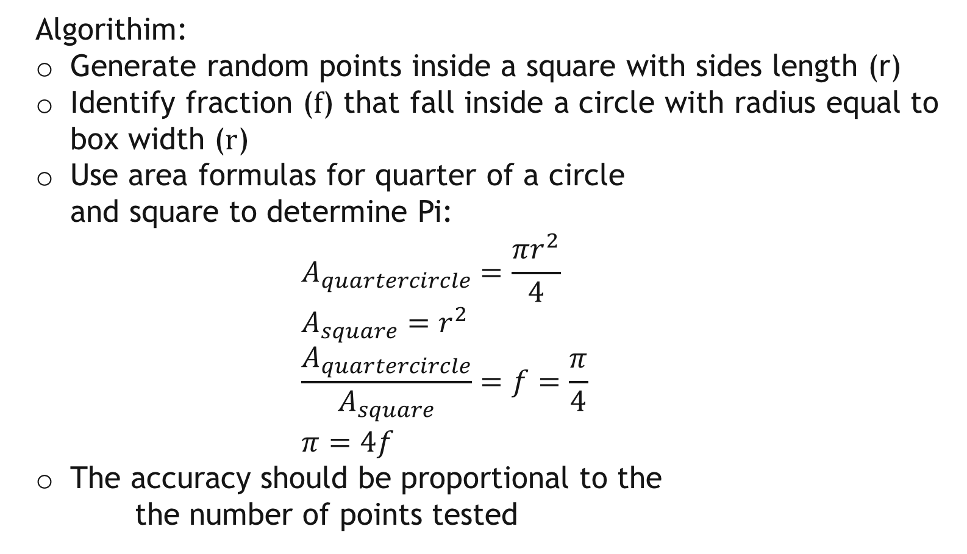
Implementation Example: Monte Carlo Calculation of Pi
Algorithim:
Generate random points inside a square with sides length (r)
Identify fraction (f) that fall inside a circle with radius equal to box width (r)
Use area formulas for quarter of a circle and square to determine Pi: $A_{quartercircle}=\frac{πr^{2}}{4}$ $A_{square}=r^{2}$ $\frac{A_{quartercircle}}{A_{square}}=f=\frac{π}{4}$ $π=4f$
The accuracy should be proportional to the the number of points tested
r

Slide 19
Questions?

Slide 20
Acknowledgments
This work is supported in part by the resources of the Argonne Leadership Computing Facility at Argonne National Laboratory, which is supported by the Office of Science of the U.S. Department of Energy under contract DE-AC02-06CH11357.
Extended thanks go to:
Continuum Analytics, Inc.
CSC
Enthought Inc.
Intel
Northwestern University
NumFocus
Lisandro Dalcin for his work on mpi4py and tolerating questions
the members of the Chicago Python User's Group (ChiPy) for allowing me to ramble on about science and HPC

